Slide 1

Restaurant Recommendation
Pablo Fúster Aizpúrua

Slide 2
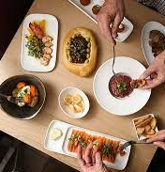
Objectives:
Get a database with most of the restaurants in Europe.
Gather some insights from that database.
Use that database, along with a another one more specific in the most important cities in Europe to get a recommendation model for when traveling.

Slide 3
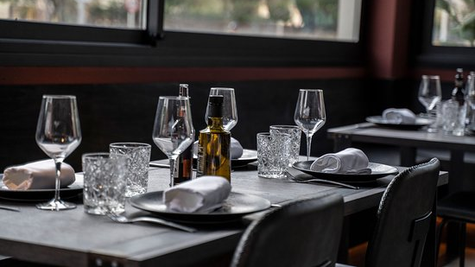
Difficulties
Huge datasets with (one with 1million rows; the other with 125.000 rows).
The data cleaning was long, with hard things like the price ranges with symbols (€€-€€€).
Lot of NaNs.
Creating the dataset and tables in SQL.

Slide 4
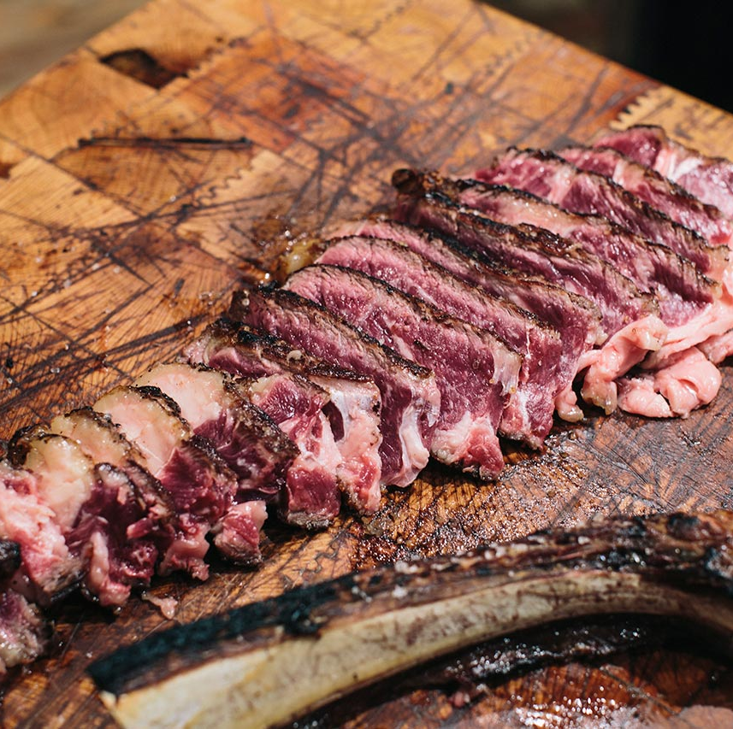
Conclusions & Next Steps
Even though I got the model working, sometimes I feel like the recommendation are not that useful, but it is not recommending for my taste but for Tripadvisor data.
Improve Tableau Dashboard.
Be able to give another recommendation if the one given is not liked.
Maybe find a better way to deal with NaNs.
Include in the model categorical variable to scale and take into account like cuisine.
Use NLP in order to evaluate reviews of the restaurant and be able to improve de model
Create interface in Streamlit.

